Slide 1
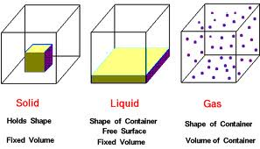
Matter Matters

Slide 2
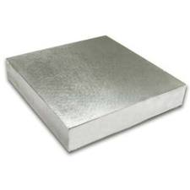
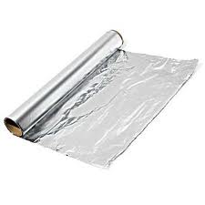
#1 Physical OR Chemical Change?
Before
Piece of Aluminum Metal
After
Sheet of Aluminum Foil
Hammered into

Slide 3
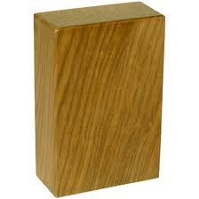
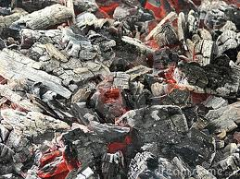
#2 Physical OR Chemical Change?
Before
Wood Block
After
Wood Ashes
burned

Slide 4
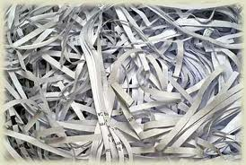
#3 Physical OR Chemical Change?
Before
Sheet of Paper
After
Shredded paper
Torn up

Slide 5
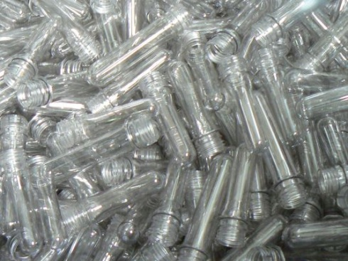
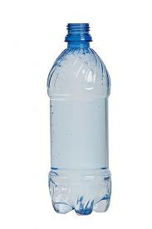
#4 Physical OR Chemical Change?
Before
Plastic form
After
Plastic bottle
Molded

Slide 6
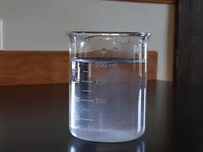
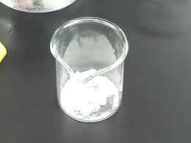
#5 Physical OR Chemical Change?
Before
Salt Water
Before
Salt Crystals
Evaporated

Slide 7
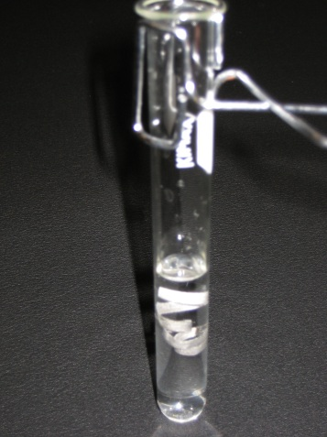
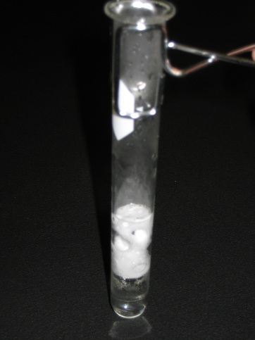
#6 Physical OR Chemical Change?
Before
Magnesium placed in acid
After
Gas bubbles form
React

Slide 8
#7 Physical OR Chemical Change?
Before
Magic Ink + vinegar
After
Clear liquid
Color Changes

Slide 9
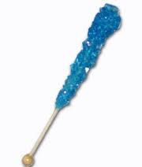
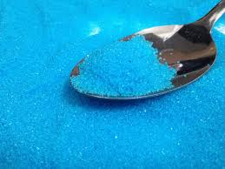
#8 Physical OR Chemical Change?
Before
Large sugar crystals
After
Small sugar crystals
Crushed

Slide 10
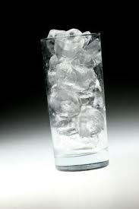
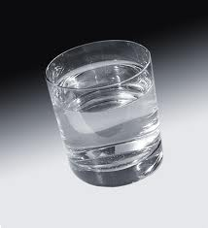
#9 Physical OR Chemical Change?
Before
Ice Cubes
After
Glass of water
Melted

Slide 11
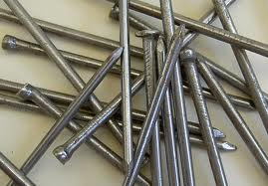
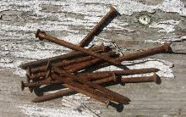
#10 Physical OR Chemical Change?
Before
Iron nails
After
Rusty nails
Exposed to Moisture

Slide 12
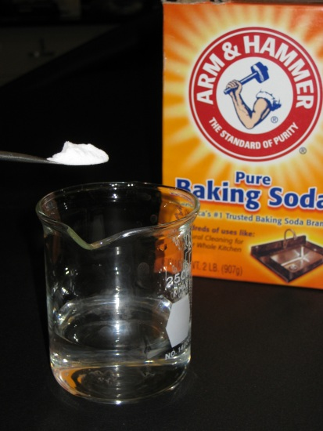
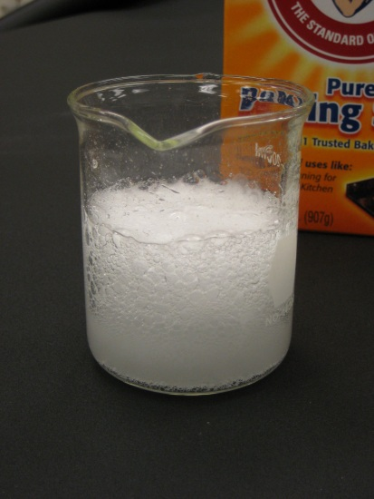
#11 Physical OR Chemical Change?
Before
Vinegar + Baking Soda
After
Fizzing bubbles
React

Slide 13
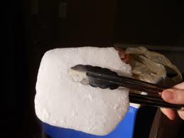
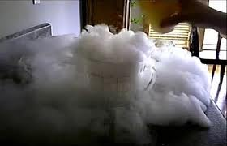
#12 Physical OR Chemical Change?
Before
Solid dry ice
After
Carbon Dioxide Gas
Changes State

Slide 14
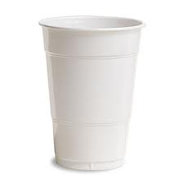
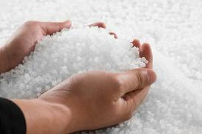
#13 Physical OR Chemical Change?
Before
Plastic pellets
After
Plastic cup
Recycled

Slide 15
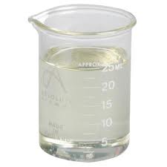
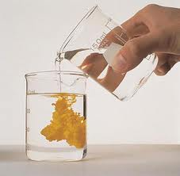
#14 Physical OR Chemical Change?
Before
Two Clear solutions
After
Powdery Yellow solid
React to Form

